Slide 1

LIONESS FILM
PRODUCTIONS
INVESTOR DECK
Cinematic IP. Creative Infrastructure. Long-Term Value.
Gold Coast, Queensland, Australia
CONFIDENTIAL

Slide 2
THE OPPORTUNITY
We are building more than a film company.
Two complementary commercial engines designed to create both recurring revenue and long-term IP value.
ENGINE ONE
ENGINE TWO
ORIGINAL FILM &
TELEVISION IP
STUDIOS, SERVICES
& ASSET HIRE
A growing portfolio of feature films, television series and expandable story worlds.
Revenue-generating facilities, equipment and creative services serving Lioness productions and external clients.
LONG-TERM UPSIDE
RECURRING REVENUE

Slide 3
INVESTMENT THESIS
Why Lioness?
Seven reasons the model is designed to create a stronger, more resilient entertainment business.
01
02
03
04
OWNED IP
PORTFOLIO MODEL
PROOF OF EXECUTION
CULTURAL DISTINCTION
Build value in original stories and rights.
A slate — not a single-project bet.
INWARD moved from concept to completion.
Māori, Polynesian and diverse perspectives.
05
06
07
MULTIPLE REVENUE STREAMS
AUSTRALIAN BASE
LONG-TERM VALUE
IP + studios + hire + services + events.
Gold Coast production ecosystem.
Rights, catalogue, assets and brand equity.

Slide 4
THE LIONESS MODEL
From story to lasting IP.
A disciplined pathway from development to commercialisation and extension.
1
2
3
4
5
6
7
8
DEVELOP
OWN
PACKAGE
FINANCE
PRODUCE
DISTRIBUTE
MONETISE
EXTEND
Original concepts
Protect rights
Scripts + budgets
Capital + partners
Create the work
Reach audiences
Revenue pathways
Sequels + franchises
CREATE IT. OWN IT. PRODUCE IT. GROW IT.

Slide 5
IP PORTFOLIO
A growing slate across film and television.
A portfolio approach spreads creative risk and opens multiple audience and commercial pathways.
MADISON HIGH
PREMORTAL WORLD
COLOURLESS
TE IKA
HOW TO SCORE A LOSER
Teen Drama
Epic Fantasy · 6-film saga
Supernatural Drama
Māori / Indigenous Fantasy
Romantic Comedy
WARRIOR WOMEN
SHADOW OF A WARRIOR
SO IS HE
LIBERTY COLLEGE
THE COMPOUND
Historical Drama
Crime Drama
Family / Psychological Drama
13-episode TV series
13-episode TV series
Current slate drawn from Lioness Film Productions project materials and website; project status and financing remain subject to development.

Slide 6
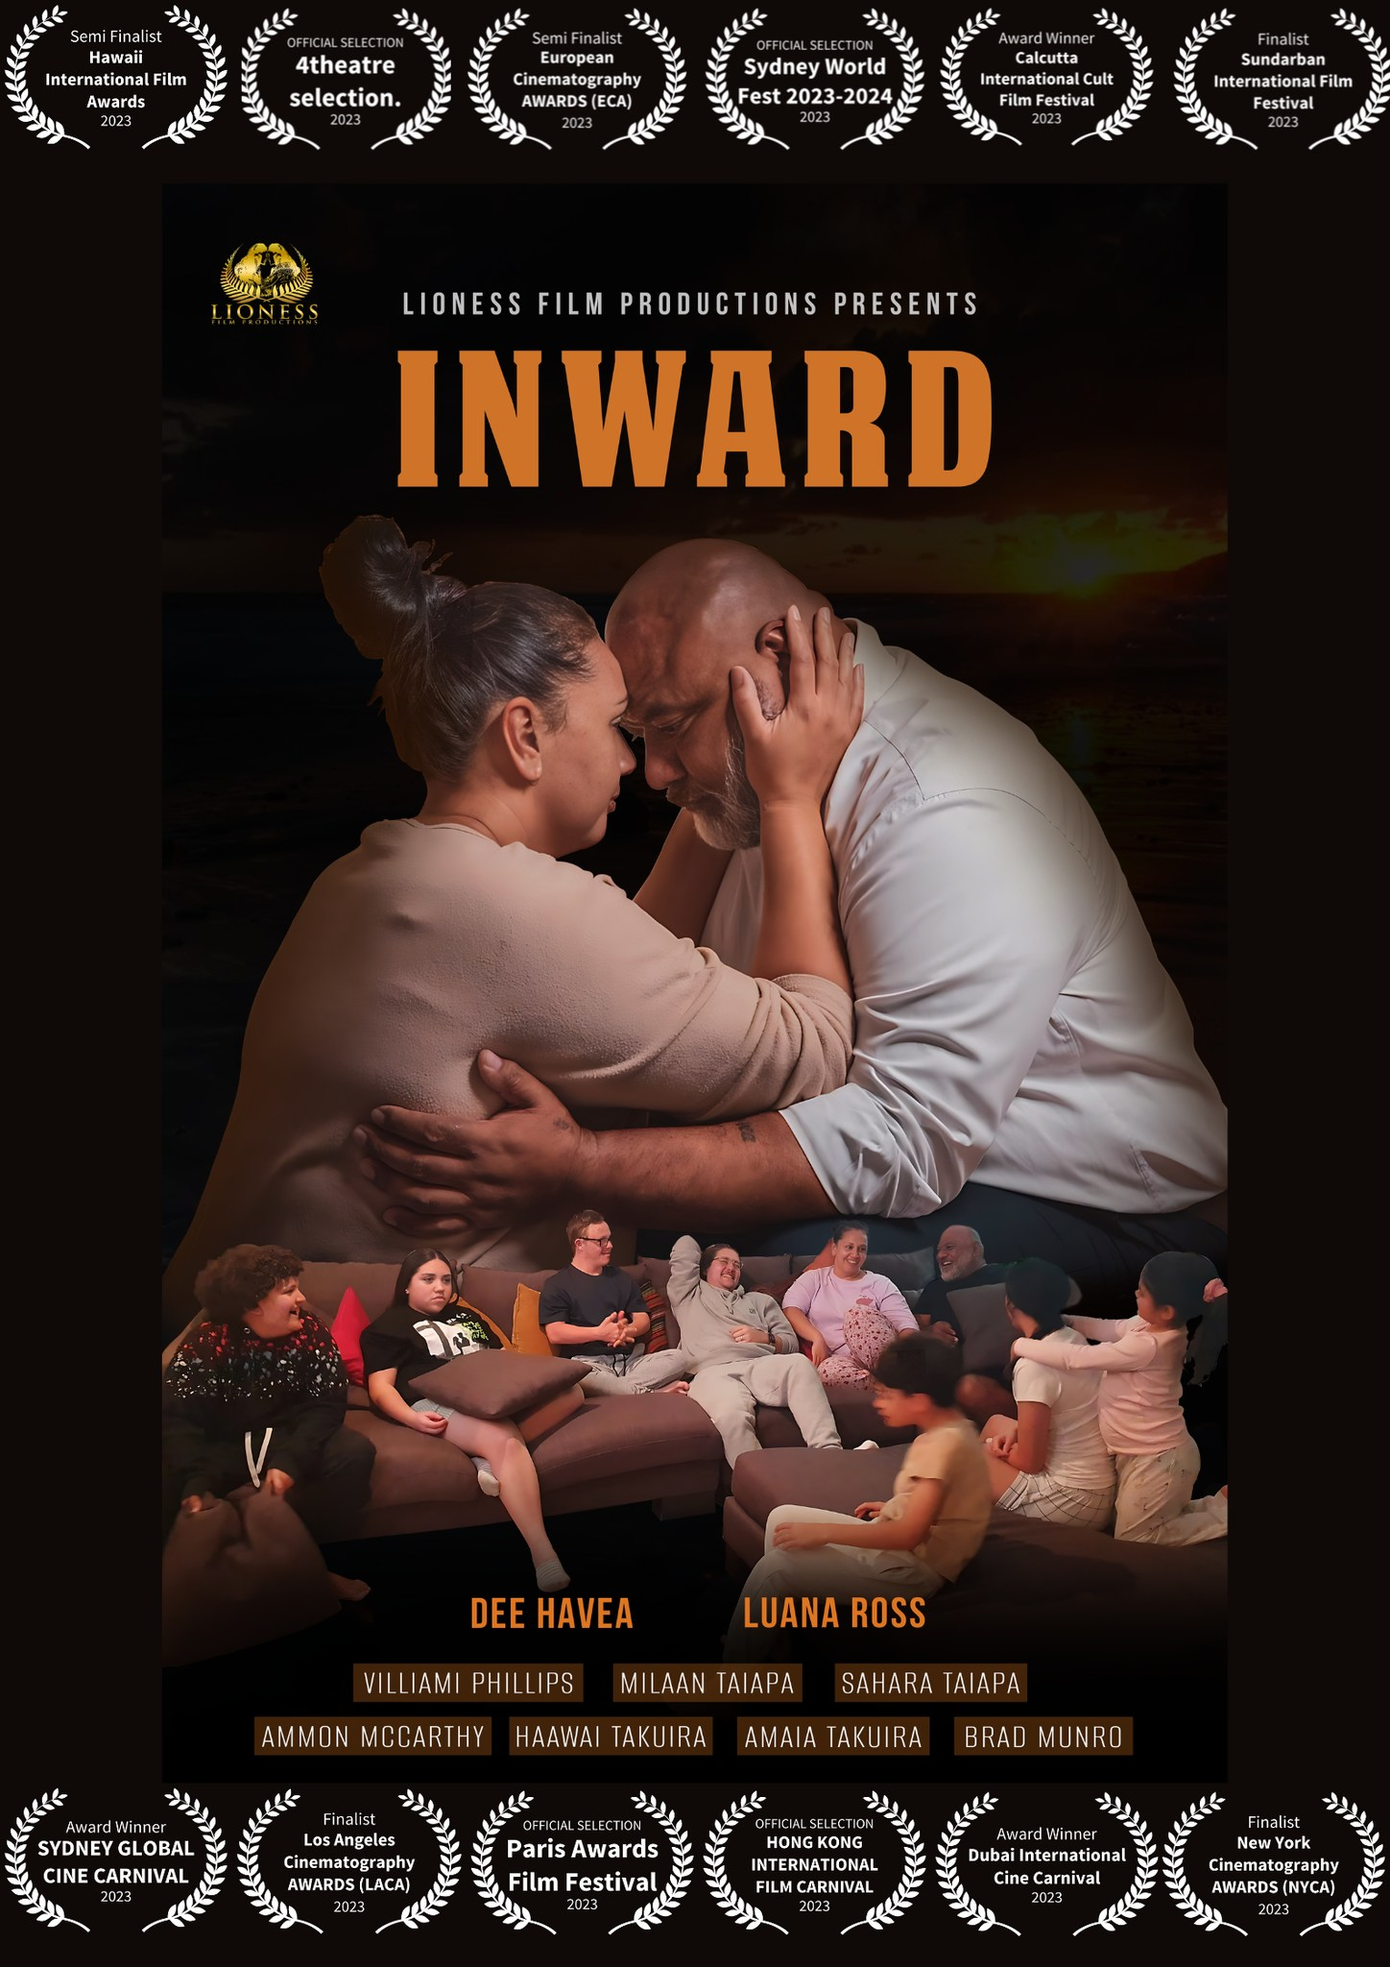
PROOF OF CONCEPT
INWARD — from page to screen.
Lioness has already demonstrated the ability to develop, assemble and complete a screen production.
INWARD
Original Lioness Film Productions short film
Concept and story development
Casting and crew assembly
Production and post-production
Completed film and public presentation
Multiple international festival selections, finalists and award wins
PROOF OF EXECUTION

Slide 7
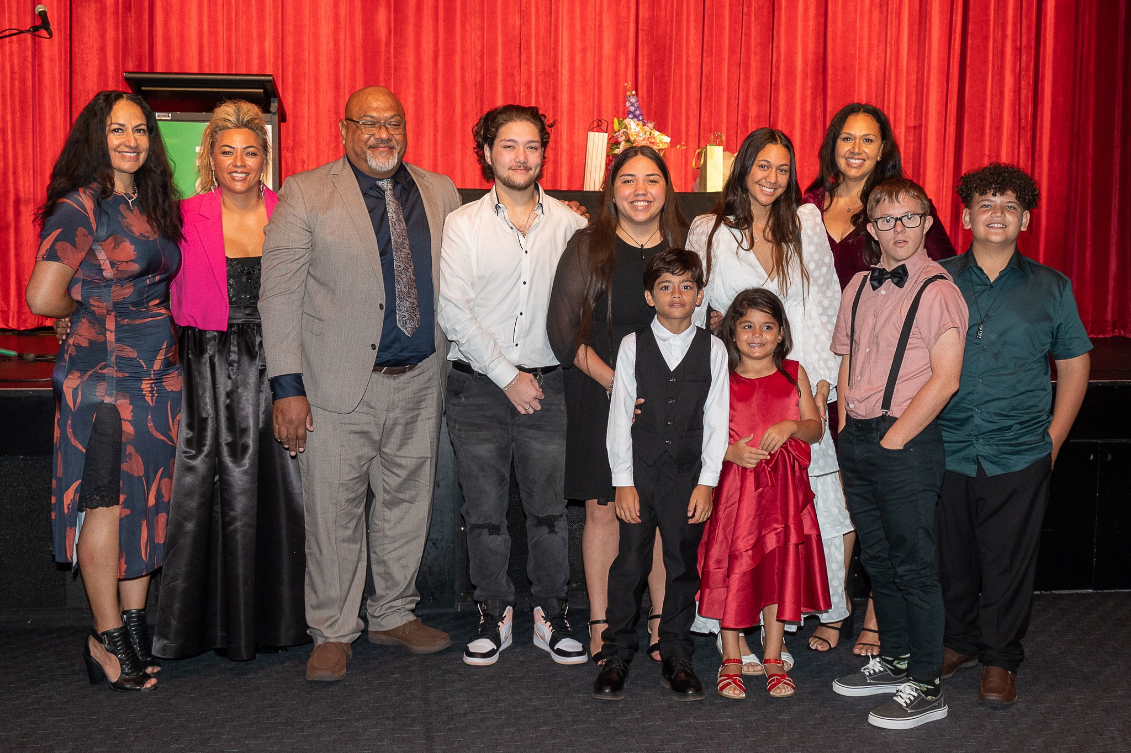
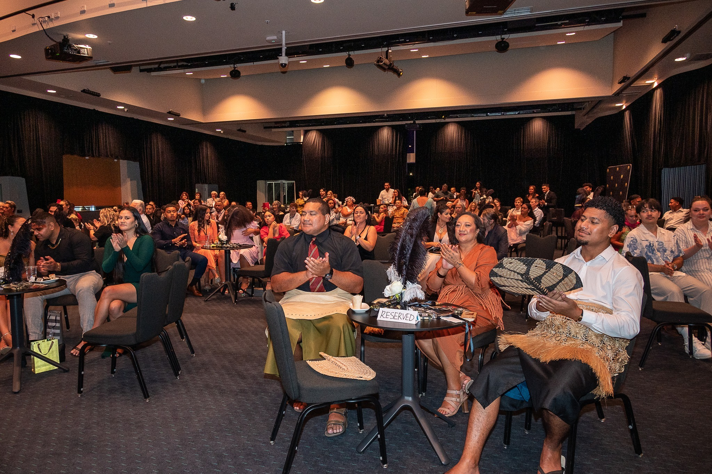
EXECUTION CAPABILITY
The foundation is already here.
Real cast, real crew, real production management, real delivery.
BUILT TEAMS · COMPLETED PRODUCTION · REACHED AUDIENCES

Slide 8

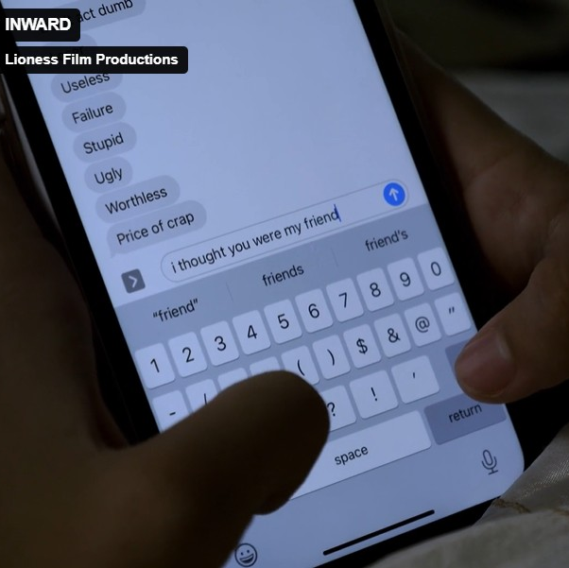
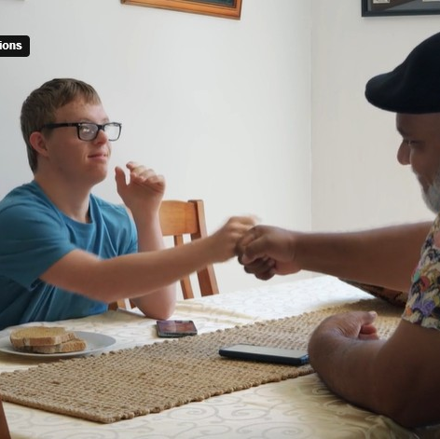
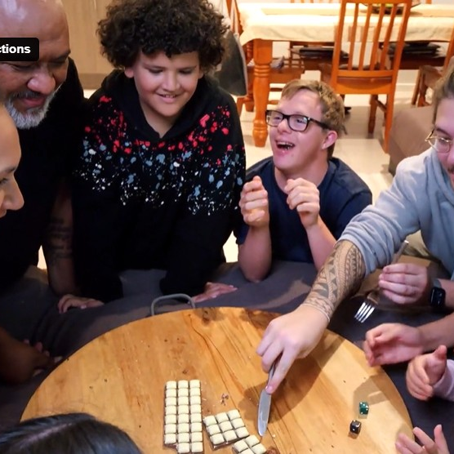
STORYTELLING IDENTITY
Emotionally grounded. Culturally distinctive. Human.
Lioness stories explore identity, family, resilience, belonging, transformation and hope.
Family & resilience
Contemporary social pressure
Inclusion & humanity
Connection & belonging
STORIES ROOTED IN CULTURE. MADE FOR THE WORLD.

Slide 9
COMMERCIAL MODEL
Two revenue engines.
Shorter-cycle operating revenue alongside long-term content value.
ENGINE ONE
ENGINE TWO
ORIGINAL SCREEN IP
STUDIOS + SERVICES
Theatrical distribution
Streaming & television licensing
International / territory sales
Digital & ancillary rights
Franchise and sequel extensions
Recording and editing suites
Camera, lighting and drone hire
Props and production resources
Event and studio hire
Pay-by-the-hour creative services

Slide 10
RECURRING REVENUE
Creative studios, services and asset hire.
The same assets can support Lioness productions and earn external revenue between projects.
RECORDING
EDITING
CAMERA + LIGHTING
DRONE
Studios · voice-over · podcasting
Suites · post · colour · sound
Hourly / daily equipment hire
Aerial filming + operator packages
PROPS
EVENTS
CREATIVE SERVICES
STUDIO HIRE
Props · wardrobe · set resources
Studio events · launches · workshops
Photography · video · content
Film · photo · green screen
HOURLY · HALF-DAY · FULL-DAY · PROJECT PACKAGES

Slide 11
COMMERCIAL FLYWHEEL
One ecosystem. Multiple uses.
Revenue-generating infrastructure supports production; production creates owned IP.
STUDIOS
EQUIPMENT
SERVICES
PRODUCTIONS
OWNED IP
Generate bookings
Generates hire revenue
Create client revenue
Use the infrastructure
Builds long-term value
REVENUE FLOWS BACK INTO THE ECOSYSTEM

Slide 12
CUSTOMER ECOSYSTEM
A broad commercial audience for Lioness facilities and services.
The infrastructure is designed to serve internal productions and multiple external customer groups.
SCREEN
MUSIC
DIGITAL
Producers · directors · filmmakers · production companies
Artists · musicians · composers · voice talent
Podcasters · creators · influencers · online brands
EDUCATION
CORPORATE
INDUSTRY
Universities · film schools · students · emerging creatives
Video · photography · eLearning · podcasts · events
Distributors · sales agents · broadcasters · production partners

Slide 13
GROWTH ROADMAP
Stage-gated growth — not growth by calendar alone.
Capital is deployed as commercial milestones are achieved.
PHASE 1
PHASE 2
PHASE 3
FOUNDATION
COMMERCIALISE
SCALE
0–12 months
12–36 months
24–60 months
Prioritise slate
Strengthen IP / chain of title
Develop budgets and finance plans
Acquire priority revenue-generating assets
Build investor + industry pipeline
Increase studio/service revenue
Finance priority productions
Enter production
Develop sales/distribution relationships
Reinvest in IP development
Expand catalogue
Increase recurring production
Expand facilities where utilised
Develop franchises where validated
Grow interstate / international partnerships

Slide 14
USE OF CAPITAL
Build assets that accelerate both production and revenue.
Capital allocation remains subject to final budgets and commercial priorities.
IP DEVELOPMENT
CAMERA + LIGHTING
RECORDING
EDITING
Scripts · packaging · legal/IP
Core production and hire assets
Voice · music · podcast capability
Suites and post-production
DRONE
PROPS
STUDIO SPACES
BUSINESS DEVELOPMENT
Aerial production capability
Reusable production resources
Production and event infrastructure
Partnerships · markets · commercial growth
PRINCIPLE: PRIORITISE ASSETS THAT CAN SUPPORT PRODUCTIONS AND / OR GENERATE REVENUE.

Slide 15
GOVERNANCE
Creativity backed by disciplined commercial controls.
Investor confidence depends on transparency, ownership clarity and milestone-based deployment.
Project-specific budgets
Expenditure approvals
Transparent accounting
Insurance
Contract management
IP registers
Chain-of-title documentation
Production reporting
Management oversight
Professional legal + financial advice
MILESTONE-BASED CAPITAL DEPLOYMENT · FORMAL REPORTING · CONTROLLED GROWTH

Slide 16
FOUNDING CIRCLE
Participation. Access. Experience. Legacy.
A limited private participation program for people who want a deeper connection to the early Lioness journey.
WHAT IS NOT SHOWN PUBLICLY
LIONESS FOUNDING CIRCLE
Contribution amounts
Number of places by tier
Studio-credit benefits
Casting / cameo participation
Detailed participation terms
A limited group recognised as part of the beginning of Lioness Film Productions.
PRIVATE INFORMATION PACK
Full participation levels, contributions, benefits, availability and terms are provided privately by email upon request.

Slide 17
WHAT WE ARE BUILDING
A connected entertainment and production ecosystem.
The goal is not one film — it is a platform from which multiple projects and revenue streams can grow.
STORIES
IP
TALENT
INFRASTRUCTURE
REVENUE
BRAND
Original concepts
Rights + catalogue
Creative network
Studios + assets
Services + hire
Distinctive identity
BUILDING ENTERPRISE VALUE THROUGH CONTENT + ASSETS + REVENUE + BRAND

Slide 18
LIONESS FILM PRODUCTIONS
Stories rooted in culture.
Made for the world.
Cinematic IP. Cultural Power. Long-Term Value.
Investor and Founding Circle enquiries
info@lionessfilmproductions.com.au
CONFIDENTIAL

