Slide 1

Lioness Film Productions
Building cinematic IP ecosystems with long-term investor value and reshaping modern film investment.

Slide 2
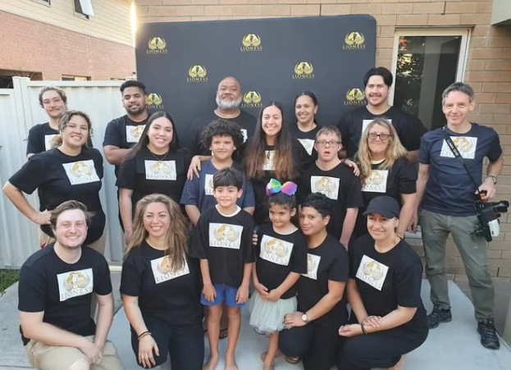

The Problem
Traditional film financing is broken. Investors are asked to fund emotion without structured asset protection.
Emotion alone no longer secures sophisticated capital.
Structure, recurring yield and brand longevity do.

Slide 3
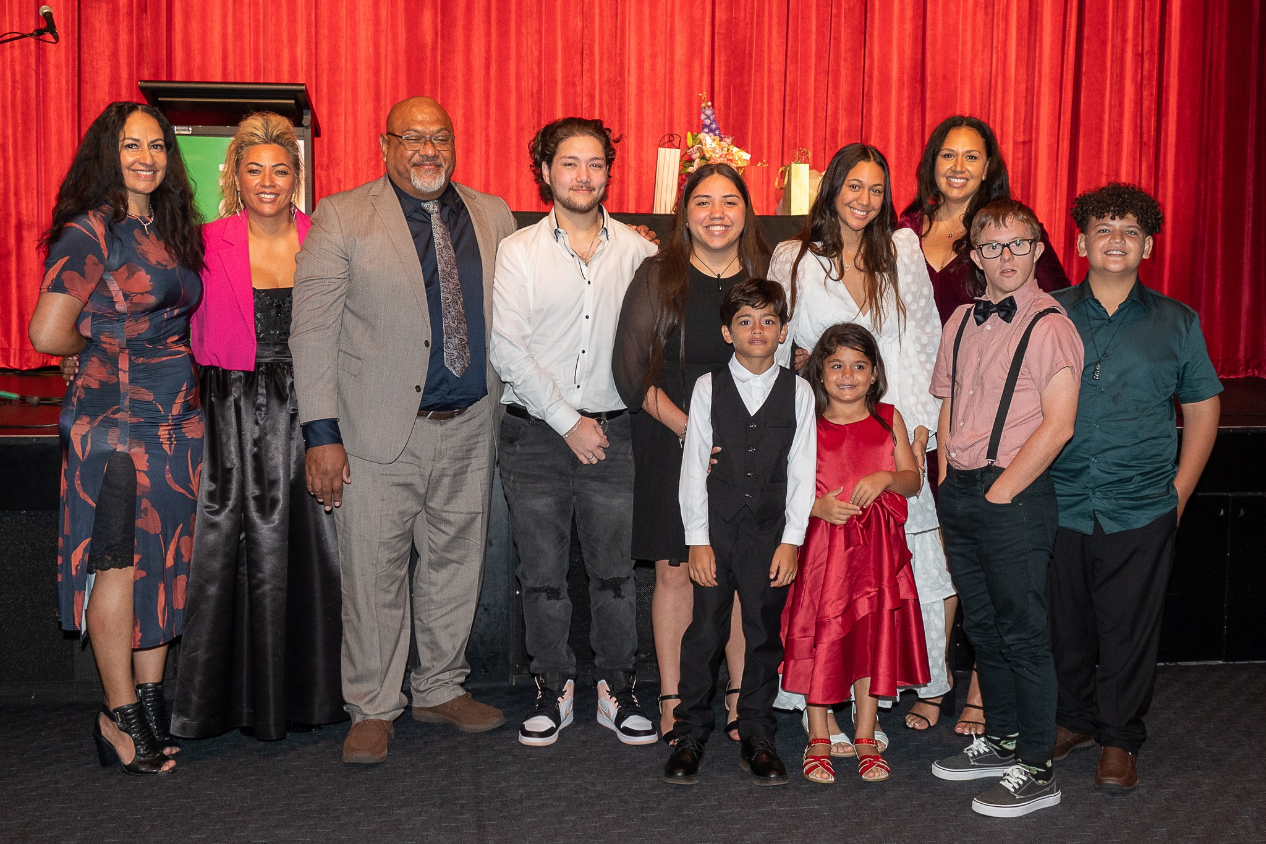
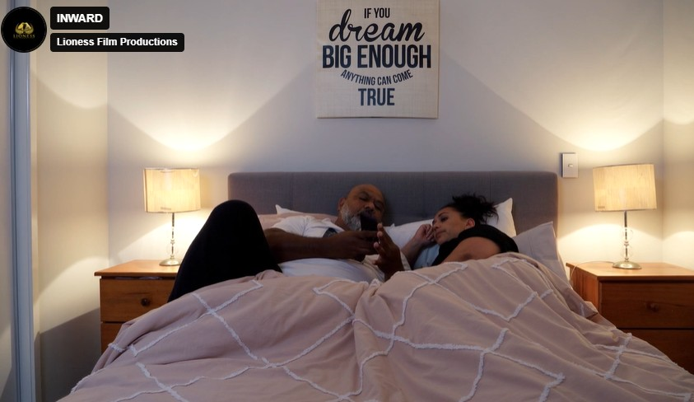
The Opportunity
Entertainment IP connected to tourism, hospitality, luxury experiences, memberships and licensing creates recurring revenue.
Lioness Film Productions develops
cinematic intellectual property designed
for multi-platform monetisation.

Slide 4
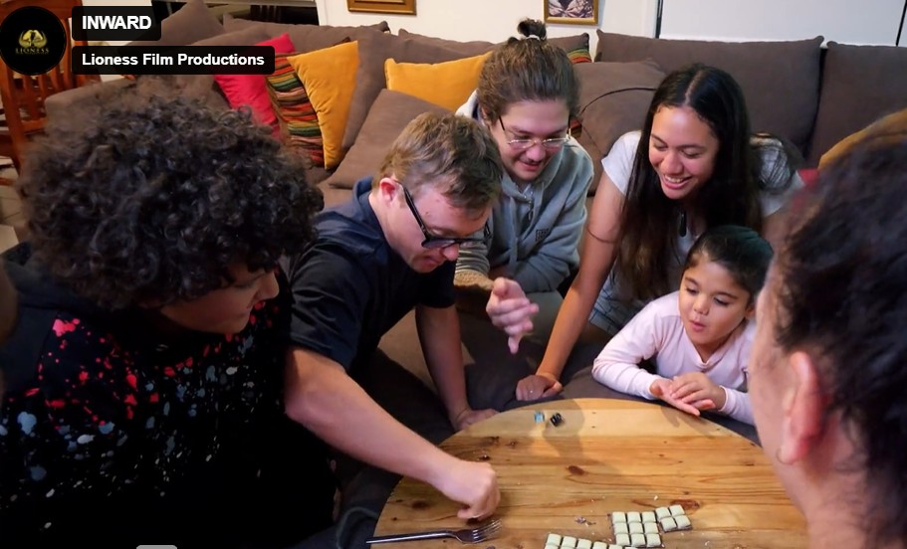
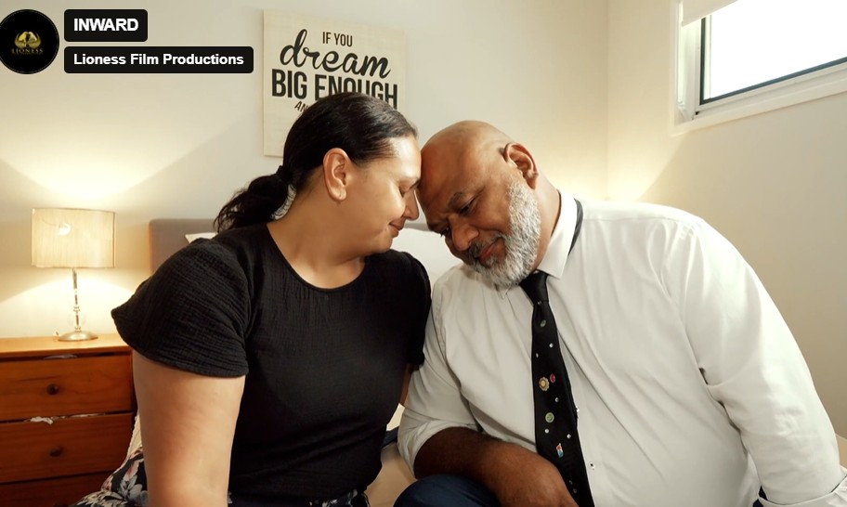
Why Lioness
Authentic Polynesian and marginalized storytelling with global appeal, proven festival traction and owned intellectual property.
Authentic Polynesian and underrepresented
storytelling creates global emotional
connection and audience loyalty.

Slide 5
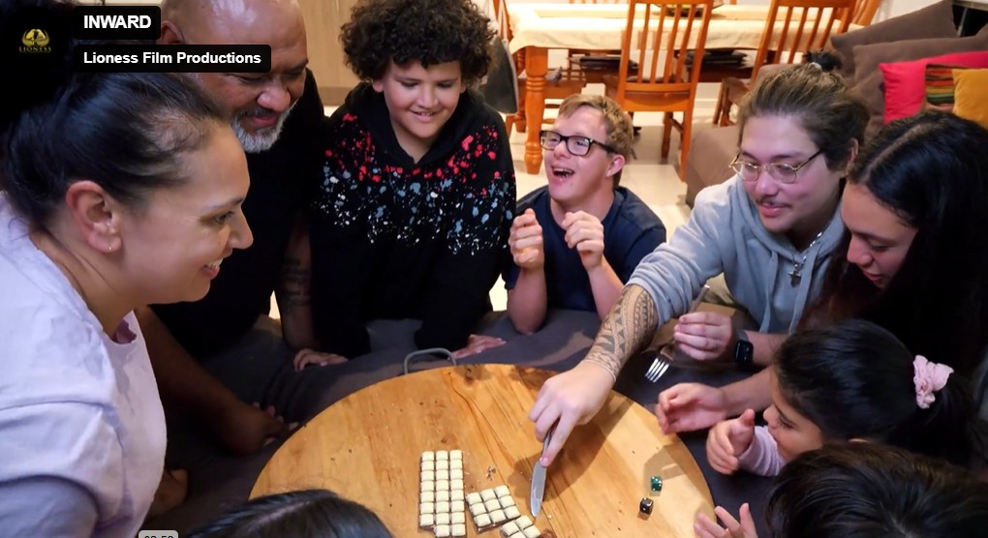
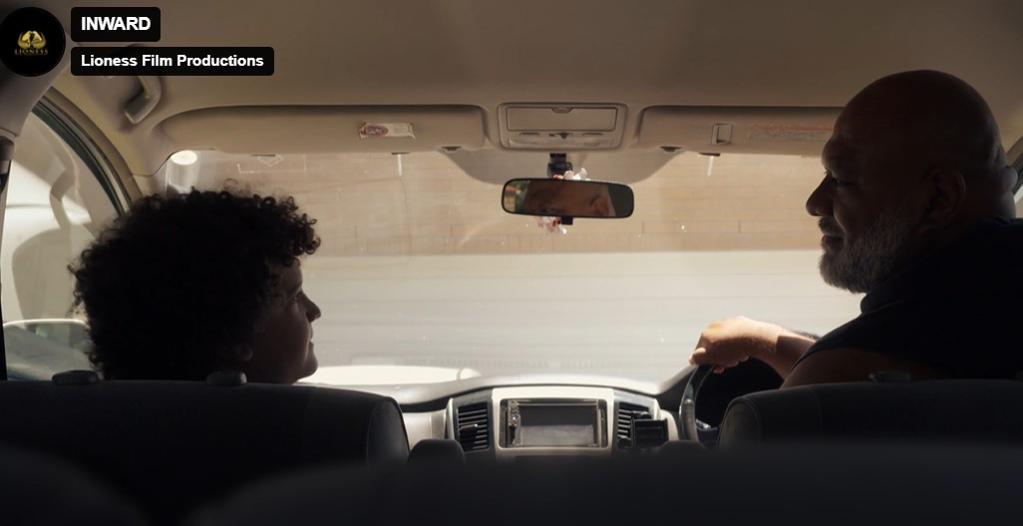
Inward Success
33 festival entries, 15 nominations and multiple international awards established Lioness Film Productions as an emerging voice.
The award-winning short film INWARD proved audience
demand for emotionally grounded cultural storytelling.

Slide 6
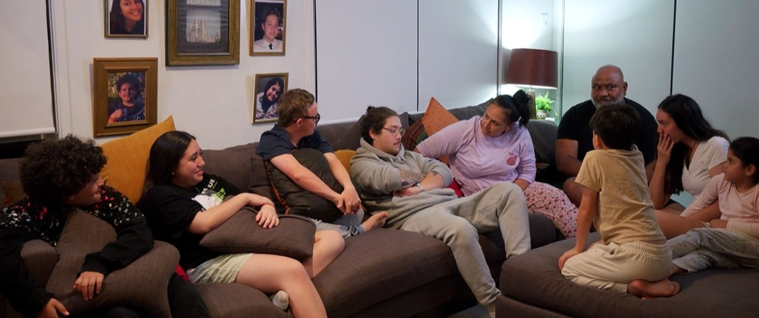

Audience & Cultural Impact
Lioness connects storytelling to wellness,
education, and experiential opportunities.
Stories that resonate deeply with underrepresented communities create loyal audiences and long-term engagement.

Slide 7
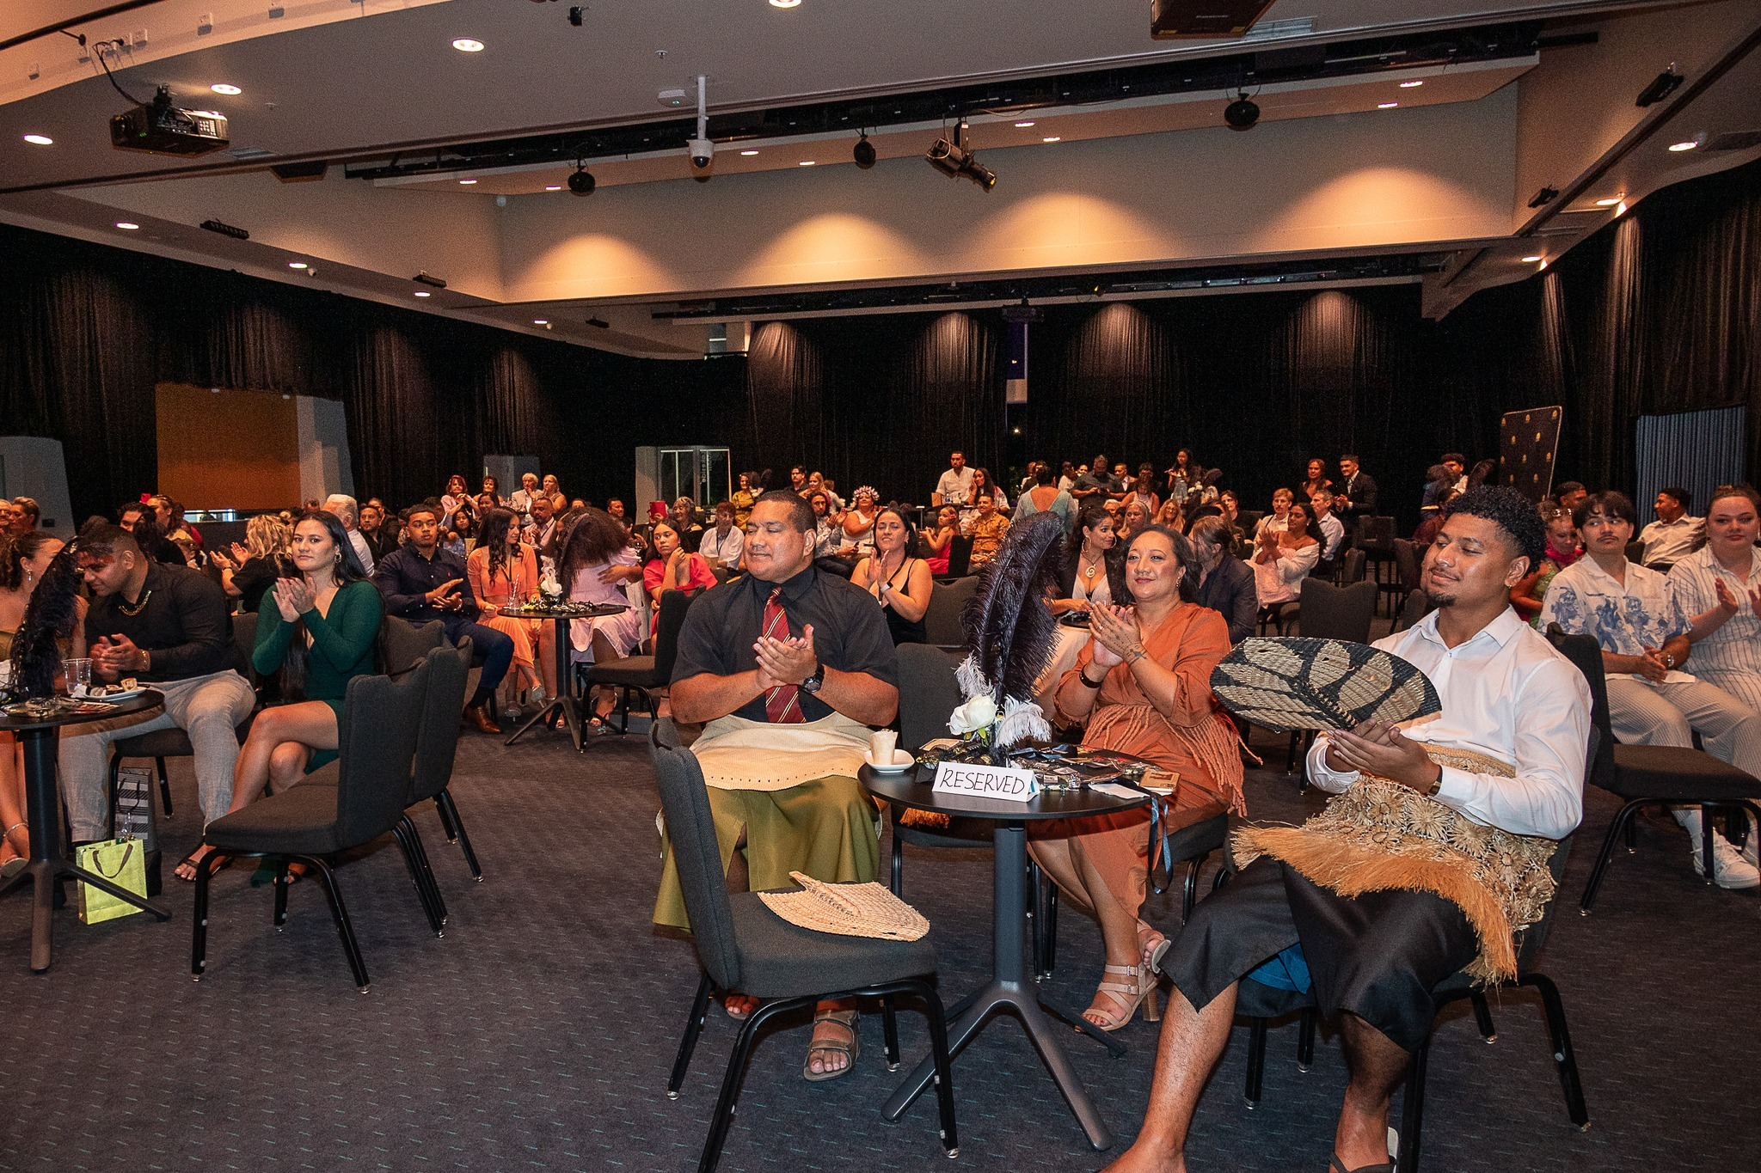
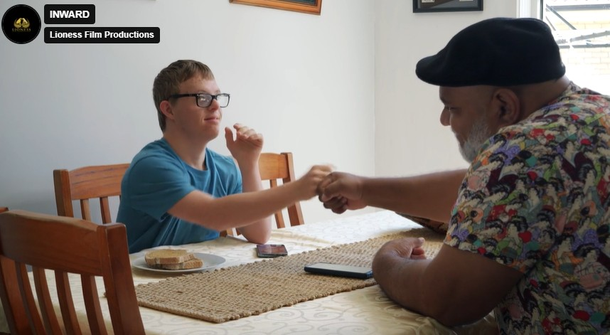
The Ecosystem Model
Film becomes the centre of a broader brand ecosystem: events, streaming, education, tourism and partnerships.
This model expands intellectual property beyond a single release cycle into long-term assets.

Slide 8
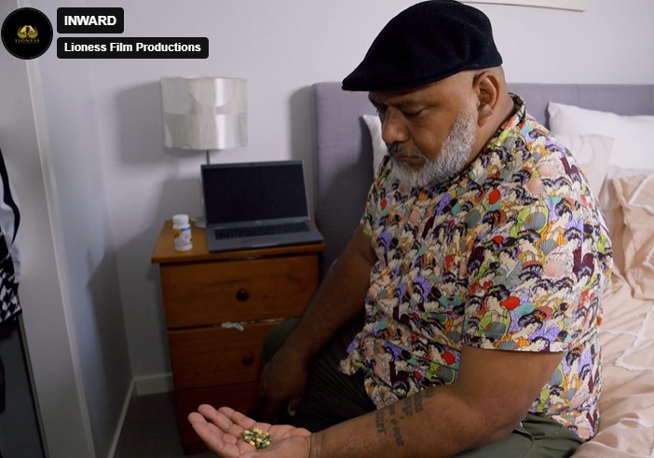
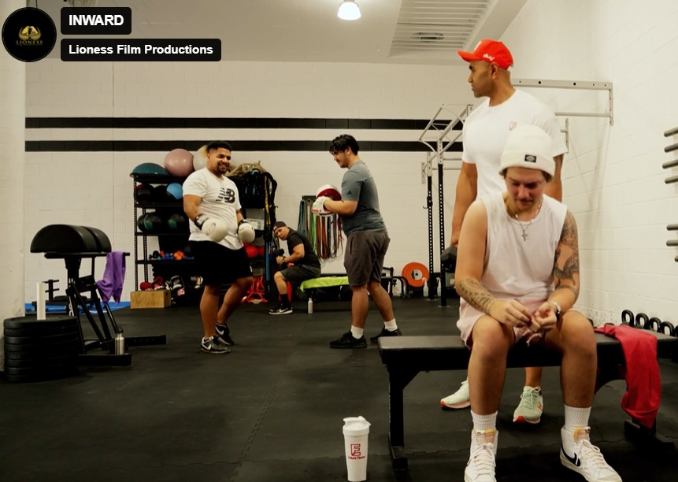
Revenue Streams
Studio hire, streaming, licensing, branded content, eLearning, sponsorships, memberships and experiential activations.
Revenue streams include streaming, licensing, branded partnerships, studio hire, events and digital education.

Slide 9
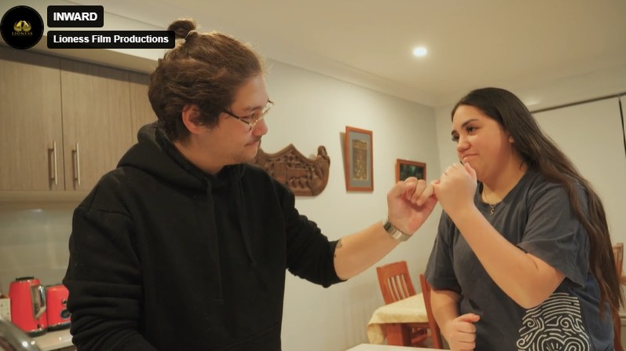

Investor Positioning
Cultural impact, recurring yield and scalable intellectual property assets.
Investors gain positioning within a premium impact-driven entertainment brand with scalable reach.

Slide 10
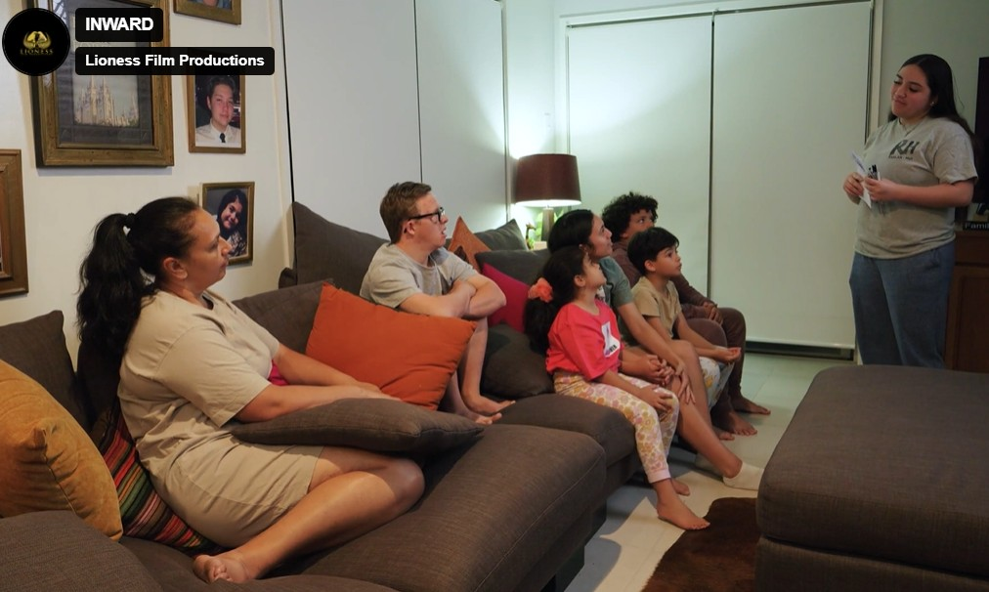
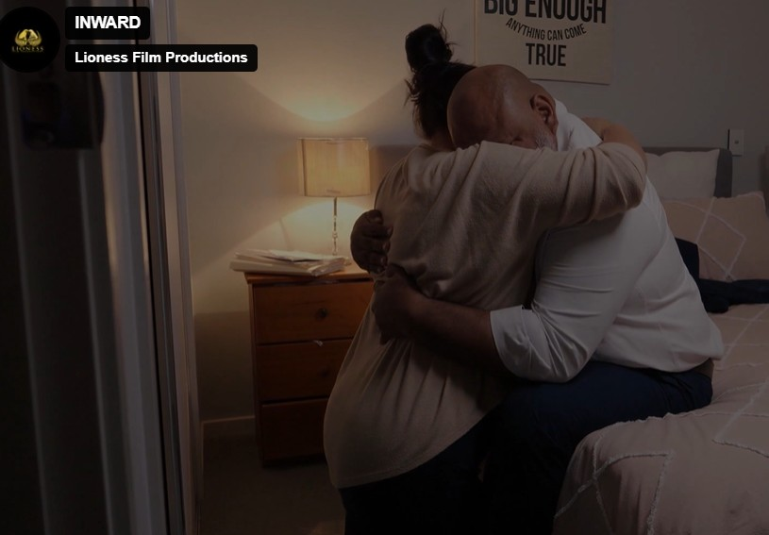
Production Capability
Lioness Film Productions already operates with established crews, talent pools, community engagement and production experience.
Existing production capability, established community trust and proven execution reduce early-stage risk.

Slide 11
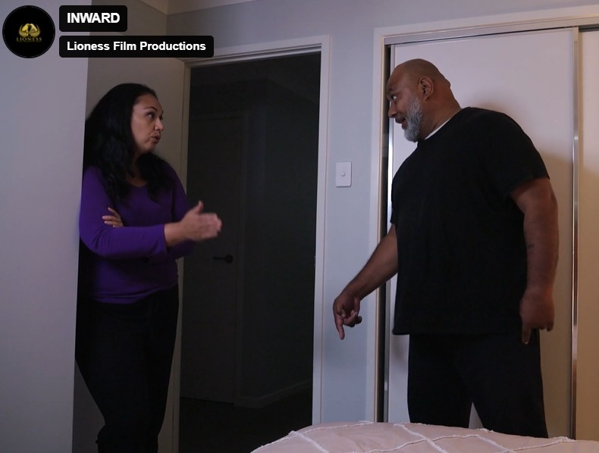
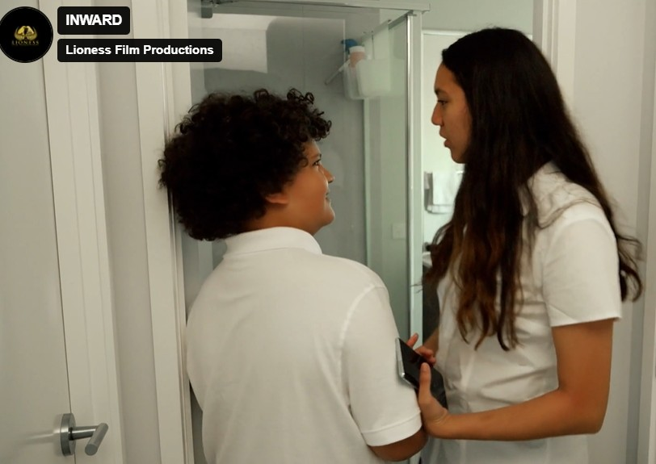
Sustainability & Social Impact
A commitment to sustainability, inclusion and empowering women and marginalized creatives.
The company aligns sustainability, inclusion and social impact with commercially viable entertainment.

Slide 12
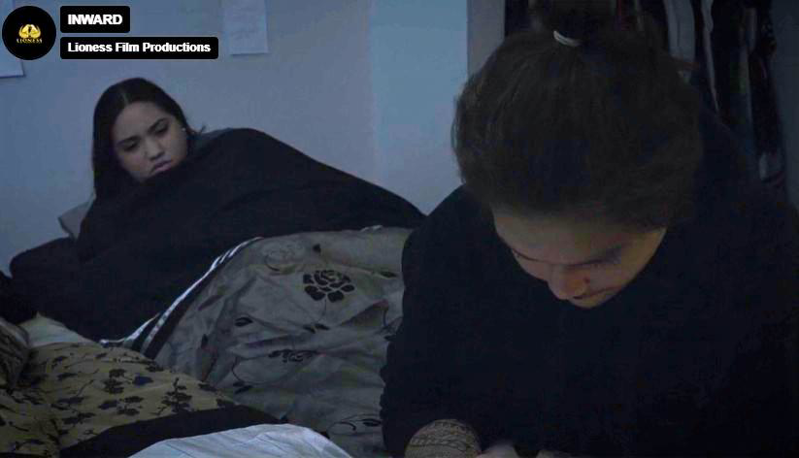
Growth Vision
Expansion into streaming series, branded experiences, studio facilities, training and international collaborations.
Expansion plans include episodic streaming content, branded experiences and international collaborations.

Slide 13
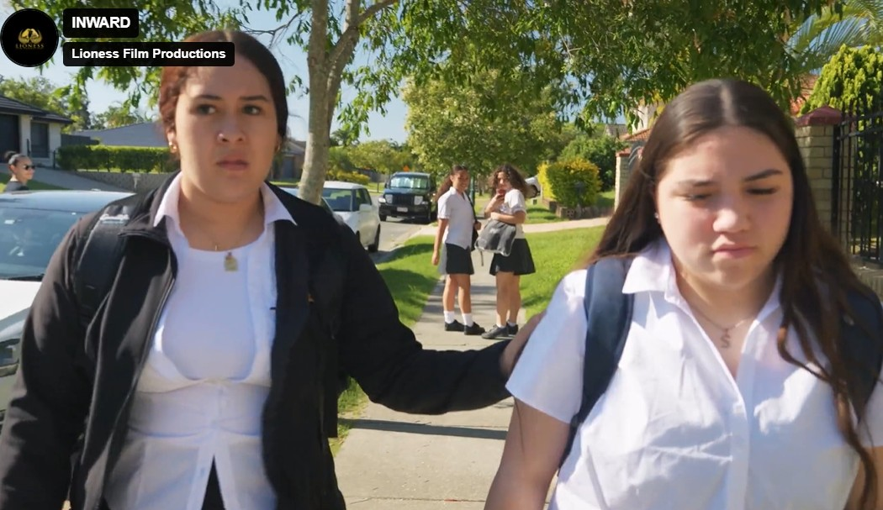
Investment Opportunity
Seeking aligned strategic investors to scale Lioness Film Productions into a globally recognized entertainment brand.
Lioness Film Productions is building the next generation of culturally-driven entertainment infrastructure.

Slide 14
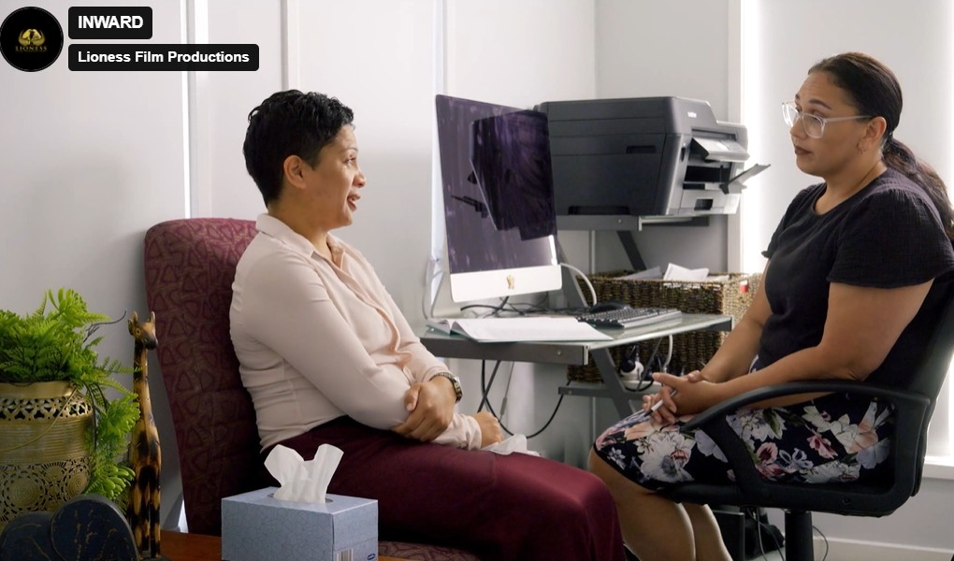
LIONESS FILM PRODUCTIONS
Cinematic IP. Cultural Power. Long-Term Value.
Investor Deck 2026

Slide 15
LIONESS FILM PRODUCTIONS
Prestige Storytelling. Cultural Power. Scalable Intellectual Property.
INVESTMENT DECK 2026

